Slide 1
Natrual Language Processing
NLP

Slide 2

Copyright Notice
These slides are distributed for educational purpose under the Creative Commons License. https://creativecommons.org/licenses/by-sa/2.0/legalcode
Source of Slides:
DeepLearning.AI as the source of the slides.
Generative AI :)
Harvard Teaching and Learning Consortium
Speech and Language Processing Book (3rd ed. draft) by Dan Jurafsky and James H. Martin, August 20, 2024

Slide 3
Introduction to NLP

Slide 4
NLP definition
Natural Language Processing (NLP) is a field of artificial intelligence (AI) that focuses on the interaction between computers and humans through natural language.
The goal of NLP is to enable computers to understand, interpret, and generate human language in a way that is both meaningful and useful

Slide 5
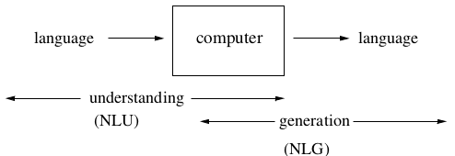
What is Natural Language Processing?
Computers using natural language as input and/or output
NLP = NLU + NLG

Slide 6
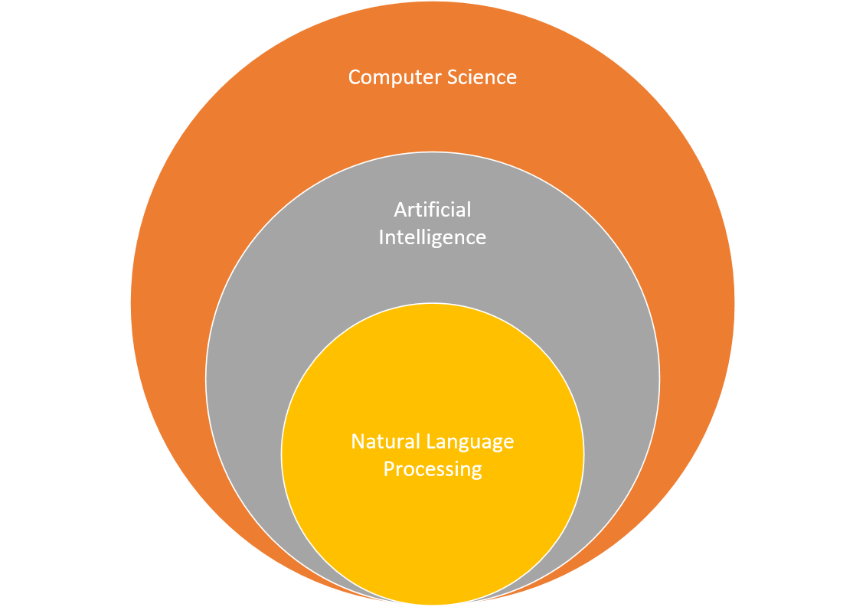
NLP & AI
Computer Science
Programming
Operating Systems
Databases
…
Artificial Intelligence
Problem Solving
Optimization
Robotics
Machine Learning
Computer Vision
Natural Language Processing
…..

Slide 7
NLP fields
NLP combines computational linguistics, computer science, and machine learning to process and analyze large amounts of natural language data.

Slide 8
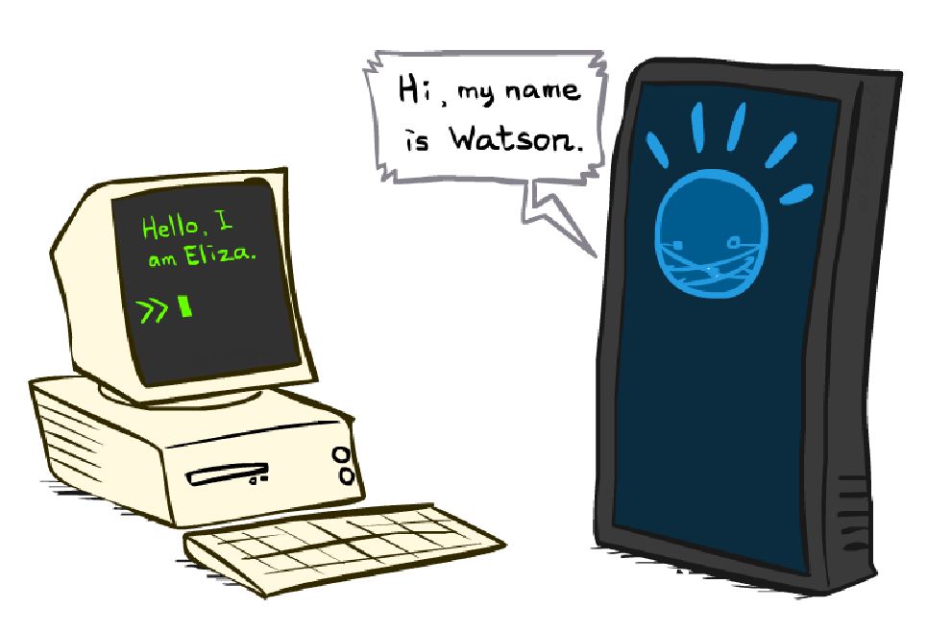
From Eliza to Watson!

Slide 9
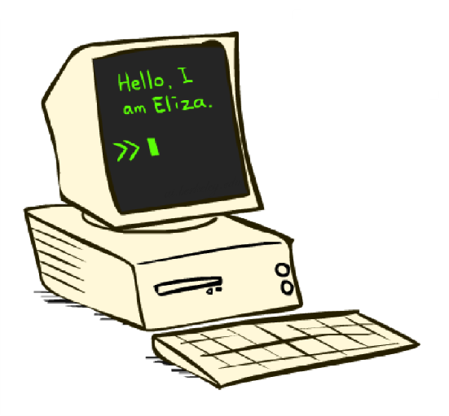
ELIZA
A “psychotherapist” agent (Weizenbaum, ~1964)
Led to a long line of chatterbots
How does it work:
Trivial NLP: string match and substitution
Trivial knowledge: tiny script / response database
Example: matching “I remember __” results in “Do you often think of __”?
Can fool some people some of the time?

Slide 10
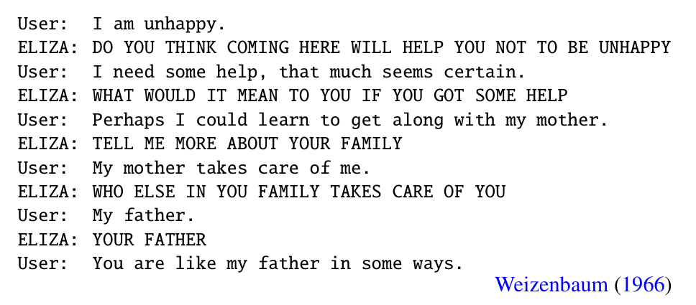
Eliza

Slide 11
What’s in Watson?
A question-answering system (IBM, 2011)
Designed for the game of Jeopardy
How does it work:
Sophisticated NLP: deep analysis of questions, noisy matching of questions to potential answers
Lots of data: onboard storage contains a huge collection of documents (e.g. Wikipedia, etc.), exploits redundancy
Lots of computation: 90+ servers
Can beat all of the people all of the time?

Slide 12
Some NLP Tasks
Text Analysis: Understanding the structure and meaning of text, including syntax and semantics.
Sentiment Analysis: Determining the emotional tone behind a series of words.
Machine Translation: Automatically translating text from one language to another.
Speech Recognition: Converting spoken language into text.
Text Generation: Creating coherent and contextually relevant text based on input data.
Named Entity Recognition: Identifying and classifying key elements in text, such as names, dates, and locations.
…

Slide 13
Information Extraction
Goal: Map a document collection to structured database
Motivation:
Complex searches (“Find me all the jobs in advertising paying at least $50,000 in Boston”)
Statistical queries (“How has the number of jobs in accounting changed over the years?”)

Slide 14
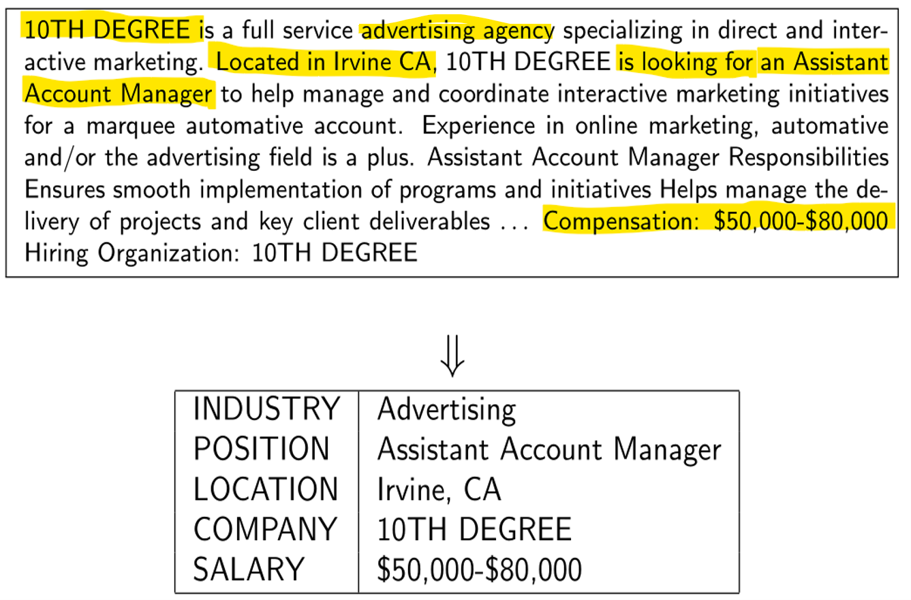
Information Extraction Example
_______________

Slide 15
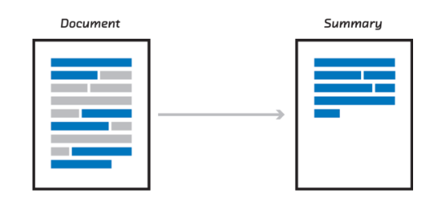
Text Summarization

Slide 16

Why is NLP Hard?

Slide 17





Ambiguity
“At last, a computer that understands you like your mother”
1. (*) It understands you as well as your mother understands you
2. It understands (that) you like your mother
3. It understands you as well as it understands your mother
1 and 3: Does this mean well, or poorly?

Slide 18
Ambiguity At the acoustic level (speech recognition)
I’m eight or duck
Eye maid; her duck
I maid her duck
I’m aid her duck
I’m ate her duck
I’m ate or duck

Slide 19



Ambiguity at the semantic (meaning) level
Two definitions of “mother”
A woman who has given birth to a child
A stringy slimy substance consisting of yeast cells and bacteria; is added to cider or wine to produce vinegar

Slide 20


More Word Sense Ambiguity semantic (meaning) level
They put money in the bank = = buried in mud?
I saw her duck with a telescope

Slide 21
Ambiguity: classified
Lexical Ambiguity: Example: "I went to the bank." Ambiguity: "Bank" could refer to a financial institution or the side of a river.
Syntactic Ambiguity: Example: "I saw the man with the telescope." Ambiguity: It’s unclear whether "with the telescope" describes the man (he has a telescope) or the speaker (the speaker used a telescope to see the man).
Semantic Ambiguity: Example: "The chicken is ready to eat." Ambiguity: It could mean that the chicken is cooked and ready for someone to eat, or that the chicken is alive and ready to eat something.
Pragmatic Ambiguity: Example: "Can you pass the salt?" Ambiguity: While it is a request, it could also be interpreted as a question about the listener's ability to pass the salt.
Anaphoric Ambiguity: Example: "John told Bill that he was going to win." Ambiguity: It’s unclear whether "he" refers to John or Bill.
Structural Ambiguity: Example: "Flying planes can be dangerous." Ambiguity: This could mean that the act of flying planes is dangerous, or that planes that are flying can be dangerous.
Homonymy: Example: "The bat flew out of the cave." Ambiguity: "Bat" could refer to the flying mammal or a piece of sports equipment.

Slide 22
Natural Language Processing

Slide 23

Regular expressions
A formal language for specifying text strings
How can we search for any of these?
woodchuck
woodchucks
Woodchuck
Woodchucks

Slide 24
Regular Expressions: Disjunctions
Letters inside square brackets []
Ranges [A-Z]
Pattern | Matches
[wW]oodchuck | Woodchuck, woodchuck
[1234567890] | Any digit
Pattern | Matches
[A-Z] | An upper case letter | Drenched Blossoms
[a-z] | A lower case letter | my beans were impatient
[0-9] | A single digit | Chapter 1: Down the Rabbit Hole

Slide 25
Regular Expressions: Negation in Disjunction
Negations [^Ss]
Carat means negation only when first in []
Pattern | Matches
[^A-Z] | Not an upper case letter | Oyfn pripetchik
[^Ss] | Neither ‘S’ nor ‘s’ | I have no exquisite reason”
[^e^] | Neither e nor ^ | Look here
a^b | The pattern a carat b | Look up a^b now

Slide 26
Regular Expressions: More Disjunction
Woodchucks is another name for groundhog!
The pipe | for disjunction
Pattern | Matches
yours|mine | yours mine
a|b|c | = [abc]

Slide 27
Regular Expressions: ? * + .
Pattern | Matches
colou?r | Optional previous char | color colour
oo*h! | 0 or more of previous char | oh! ooh! oooh! ooooh!
o+h! | 1 or more of previous char | oh! ooh! oooh! ooooh!
baa+ |  | baa baaa baaaa baaaaa
beg.n | 1 char (any char) | begin begun begun beg3n

Slide 28
The iterative process of writing regex's
Find me all instances of the word “the” in a text.
the
Misses capitalized examples
[tT]he
Incorrectly returns other or Theology
\W[tT]he\W

Slide 29
Basic Text Processing
More Regular Expressions: Substitutions and ELIZA
Notes:
Regular expression play a very powerful role when they are used to change strings, substituting one string for another. And this power to easily model string substitutions turns out to play a role in one of the earliest NLP systems, the pioneering 1966 chatbot ELIZA.

Slide 30
Substitutions
Substitution in Python and UNIX commands:
s/regexp1/pattern/
e.g.:
s/colour/color/
Notes:
The syntax for substitutions is simple. For example the python "S" command can be used to change a string matched by a regex to the substitute, another string.

Slide 31
Simple Application: ELIZA
Early NLP system that imitated a Rogerian psychotherapist
Joseph Weizenbaum, 1966.
Uses pattern matching to match, e.g.,:
“I need X”
and translates them into, e.g.
“What would it mean to you if you got X?
Notes:
Substitutions and capture groups are very useful in implementing simple chat-bots like ELIZA. ELIZA , one of the most important historical NLP systems, was created by pioneering AI researcher Joseph Weizenbaum in 1966, and simulates a Rogerian psychologist, a kind of therapist who emphasizes mirroring back what they hear. ELIZA is a surprisingly simple program that uses pattern matching to recognize phrases like “I need X” and translate them into suitable outputs like “What would it mean to you if you got X?”. This simple technique succeeds in this domain because ELIZA doesn’t actually need to know anything to mimic a Rogerian psychotherapist. This is one of the few dialogue genres where listeners can act as if they know nothing of the world.

Slide 32
Simple Application: ELIZA
Early NLP system that imitated a Rogerian psychotherapist
Joseph Weizenbaum, 1966.
Uses pattern matching to match, e.g.,:
“I need X”
and translates them into, e.g.
“What would it mean to you if you got X?
Notes:
Substitutions and capture groups are very useful in implementing simple chat-bots like ELIZA. ELIZA , one of the most important historical NLP systems, was created by pioneering AI researcher Joseph Weizenbaum in 1966, and simulates a Rogerian psychologist, a kind of therapist who emphasizes mirroring back what they hear. ELIZA is a surprisingly simple program that uses pattern matching to recognize phrases like “I need X” and translate them into suitable outputs like “What would it mean to you if you got X?”. This simple technique succeeds in this domain because ELIZA doesn’t actually need to know anything to mimic a Rogerian psychotherapist. This is one of the few dialogue genres where listeners can act as if they know nothing of the world.

Slide 33
Simple Application: ELIZA
Men are all alike. IN WHAT WAY
They're always bugging us about something or other. CAN YOU THINK OF A SPECIFIC EXAMPLE
Well, my friend made me come here. YOUR FRIEND MADE YOU COME HERE
He says I'm depressed much of the time. I AM SORRY TO HEAR YOU ARE DEPRESSED
Notes:
Here's some fragments from a sample conversation with ELIZA in 1966. Eliza’s mimicry of human conversation was remarkably successful: many people who interacted with ELIZA came to believe that it really understood them and their problems, and in very prescient early work, Weizenbaum pointed out the ethical issues in this attribution of human qualities to an artificial agent. We'll return to this issue in the dialogue lectures.

Slide 34
How ELIZA works
s/.* I’M (depressed|sad) .*/I AM SORRY TO HEAR YOU ARE \1/
s/.* I AM (depressed|sad) .*/WHY DO YOU THINK YOU ARE \1/
s/.* all .*/IN WHAT WAY?/
s/.* always .*/CAN YOU THINK OF A SPECIFIC EXAMPLE?/
Notes:
ELIZA consists mainly of a series of substitution patterns, with some control for deciding what pattern to select, and some higher-level dialogue structure that we'll come back to. Here we can see examples of capture groups for capturing the adjectives the user writes to describes themselves, and simple patterns for asking more details when the user uses generic statements containing "all" or "always".

Slide 35
Eliza

Slide 36




Most common NLP libraries
NLTK (Natural Language Toolkit): A comprehensive library for Python that provides tools for text processing, including tokenization, stemming, tagging, parsing, and semantic reasoning. It's widely used for educational purposes and research.
spaCy: An efficient and user-friendly library designed for production use. It offers pre-trained models for various languages and supports tasks like part-of-speech tagging, named entity recognition, and dependency parsing.
Transformers (by Hugging Face): A popular library that provides state-of-the-art pre-trained models for various NLP tasks, including text classification, translation, and summarization. It supports models like BERT, GPT, and T5.
Gensim: Primarily used for topic modeling and document similarity analysis. It excels in handling large text corpora and provides implementations of algorithms like Word2Vec and LDA (Latent Dirichlet Allocation).
TextBlob: A simple library for processing textual data. It provides a straightforward API for common NLP tasks such as sentiment analysis, noun phrase extraction, and translation.
Stanford NLP: A suite of tools developed by Stanford University that provides robust NLP capabilities, including part-of-speech tagging, named entity recognition, and parsing. It can be used via a Python wrapper called stanza.

Slide 37
NLP pipeline
An NLP (Natural Language Processing) pipeline is a series of processing steps that transform raw text into a structured format that can be analyzed and understood by machines.
The pipeline typically consists of several stages, each focusing on a specific aspect of text processing.

Slide 38
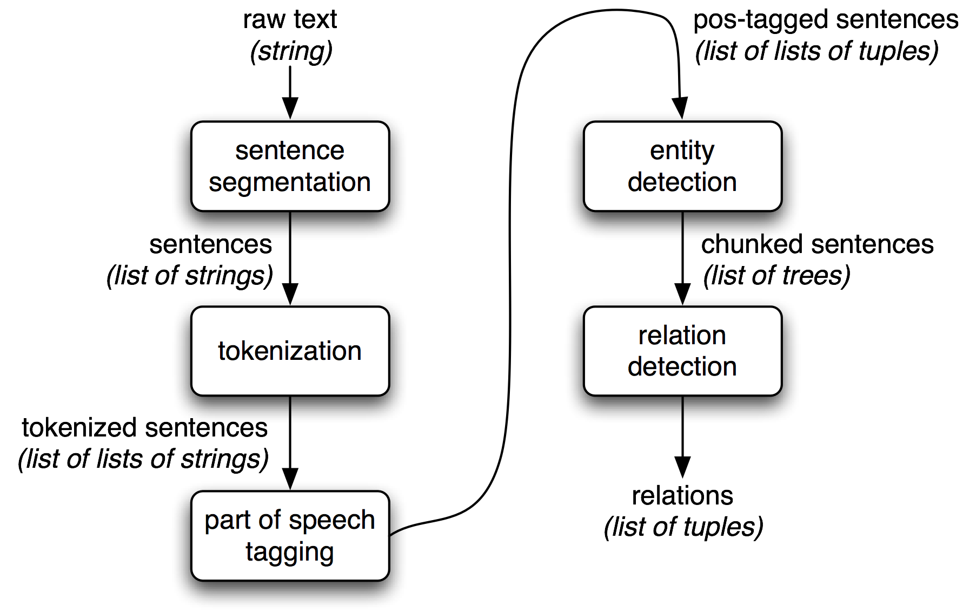
NLP pipeline

Slide 39
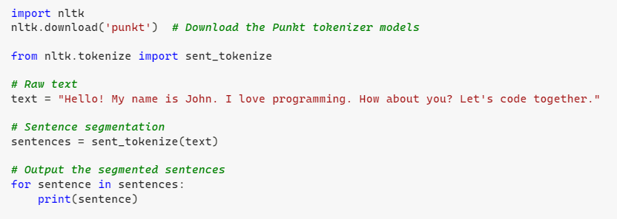
Sentence segmentation
Sentence segmentation is the process of dividing a text into individual sentences. This is a fundamental task in Natural Language Processing (NLP) and text analysis, as it helps in understanding the structure and meaning of the text.
Hello!
My name is John.
I love programming.
How about you?
Let's code together.

Slide 40
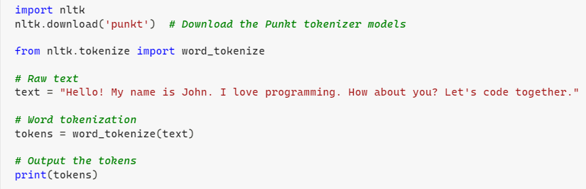
Tokenization
Tokenization is the process of breaking down text into smaller units, called tokens. These tokens can be words, phrases, or even sentences, depending on the level of tokenization being applied. In this example, we will perform word tokenization on the provided text.
['Hello', '!', 'My', 'name', 'is', 'John', '.', 'I', 'love', 'programming', '.', 'How', 'about', 'you', '?', 'Let', "'s", 'code', 'together', '.']

Slide 41
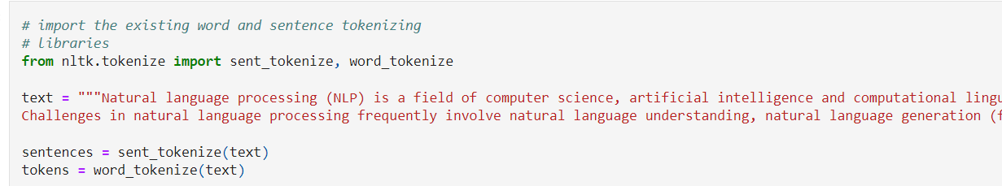
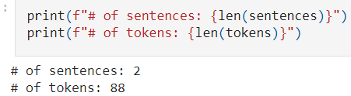

Slide 42
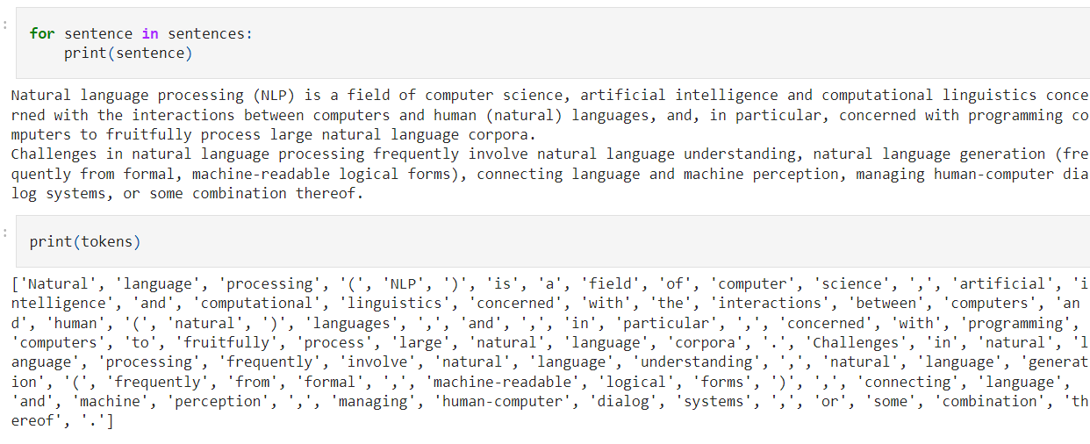

Slide 43
NLP steps
Text Acquisition: The first step involves gathering text data from various sources, such as websites, documents, or databases.
Preprocessing: This stage prepares the raw text for analysis and may include:
Tokenization: Splitting text into individual words or tokens.
Lowercasing: Converting all text to lowercase to ensure uniformity.
Removing Punctuation: Eliminating punctuation marks that may not be relevant for analysis.
Stopword Removal: Filtering out common words (e.g., "and," "the") that may not carry significant meaning.
Stemming/Lemmatization: Reducing words to their base or root form to treat different forms of a word as the same.
Feature Extraction: This step involves converting the preprocessed text into a numerical format that can be used for machine learning models. Common techniques include:
Bag of Words (BoW): Representing text as a collection of word counts.
Word Embeddings: Using techniques like Word2Vec or GloVe to represent words in a continuous vector space.

Slide 44
NLP steps
Modeling: In this stage, various machine learning or deep learning models are applied to the extracted features for specific NLP tasks, such as:
Text classification (e.g., sentiment analysis, spam detection)
Named entity recognition (NER)
Part-of-speech tagging
Machine translation
Text summarization

Slide 45
Lemmatization
Lemmatization is the process of reducing a word to its base or root form, known as a lemma. Unlike stemming, which simply removes prefixes or suffixes, lemmatization considers the context and converts the word to its meaningful base form.

Slide 46
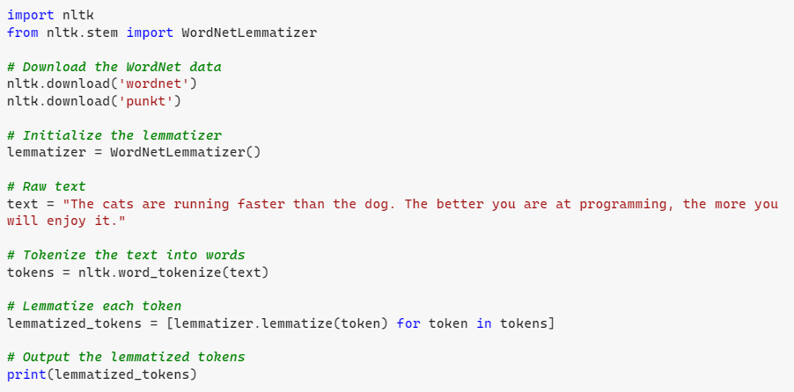
"The cats are running faster than the dog. The better you are at programming, the more you will enjoy it."
['The', 'cat', 'are', 'running', 'faster', 'than', 'the', 'dog', '.', 'The', 'better', 'you', 'are', 'at', 'programming', ',', 'the', 'more', 'you', 'will', 'enjoy', 'it', '.']

Slide 47
Stemming
Stemming is the process of reducing a word to its base or root form, known as a stem. Unlike lemmatization, stemming does not consider the context or meaning of the word; it simply removes prefixes or suffixes to achieve the root form. This can sometimes result in non-words or stems that are not actual words in the language.

Slide 48
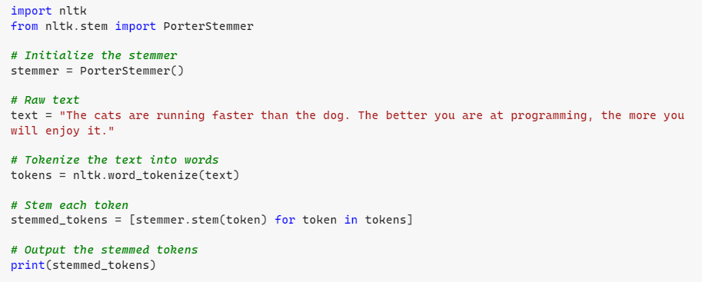
"The cats are running faster than the dog. The better you are at programming, the more you will enjoy it."
['the', 'cat', 'are', 'run', 'faster', 'than', 'the', 'dog', '.', 'the', 'better', 'you', 'are', 'at', 'program', 'the', 'more', 'you', 'will', 'enjoy', 'it', '.']

Slide 49
How many words?
I do uh main- mainly business data processing
Fragments, filled pauses
Seuss’s cat in the hat is different from other cats!
Lemma: same stem, part of speech, rough word sense
cat and cats = same lemma
Wordform: the full inflected surface form
cat and cats = different wordforms

Slide 50
How many words?
N = number of tokens
V = vocabulary = set of types
|V| is the size of the vocabulary
 | Tokens = N | Types = |V|
Switchboard phone conversations | 2.4 million | 20 thousand
Shakespeare | 884,000 | 31 thousand
Google N-grams | 1 trillion | 13 million

Slide 51
Issues in Tokenization
Finland’s capital → Finland Finlands Finland’s ?
what’re, I’m, isn’t → What are, I am, is not
Hewlett-Packard → Hewlett Packard ?
state-of-the-art → state of the art ?
Lowercase → lower-case lowercase lower case ?
San Francisco → one token or two?
m.p.h., PhD. → ??

Slide 52
Tokenization: language issues
French
L'ensemble → one token or two?
L ? L’ ? Le ?
Want l’ensemble to match with un ensemble
German noun compounds are not segmented
Lebensversicherungsgesellschaftsangestellter
‘life insurance company employee’
German information retrieval needs compound splitter

Slide 53
Tokenization: language issues
Chinese and Japanese no spaces between words:
莎拉波娃现在居住在美国东南部的佛罗里达。
莎拉波娃 现在 居住 在 美国 东南部 的 佛罗里达
Sharapova now lives in US southeastern Florida

Slide 54
Word Tokenization in Chinese
Also called Word Segmentation
Chinese words are composed of characters
Characters are generally 1 syllable and 1 morpheme.
Average word is 2.4 characters long.
Standard baseline segmentation algorithm:
Maximum Matching (also called Greedy)

Slide 55
Issues in Tokenization
Can't just blindly remove punctuation:
m.p.h., Ph.D., AT&T, cap’n
prices ($45.55)
dates (01/02/06)
URLs (http://www.stanford.edu)
hashtags (#nlproc)
email addresses (someone@cs.colorado.edu)
Clitic: a word that doesn't stand on its own
"are" in we're, French "je" in j'ai, "le" in l'honneur
When should multiword expressions (MWE) be words?
New York, rock ’n’ roll
Notes:
Of course, tokenization in most real situations isn't as simple as I've suggested with the simple UNIX tools.

Slide 56
Tokenization in NLTK
Bird, Loper and Klein (2009), Natural Language Processing with Python. O’Reilly
Notes:
So most standard tokenization programs for English or languages with similar writing systems need to deal with each of these issues. Here's a simple python tokenizer in the Natural Language Toolkit that has little regular expressions for dealing with hypthens, and currency, and whatnot

Slide 57
Maximum Matching Word Segmentation Algorithm
Given a wordlist of Chinese, and a string.
Start a pointer at the beginning of the string
Find the longest word in dictionary that matches the string starting at pointer
Move the pointer over the word in string
Go to 2

Slide 58
Normalization
Need to “normalize” terms
Information Retrieval: indexed text & query terms must have same form.
We want to match U.S.A. and USA
We implicitly define equivalence classes of terms
e.g., deleting periods in a term
Alternative: asymmetric expansion:
Enter: window Search: window, windows
Enter: windows Search: Windows, windows, window
Enter: Windows Search: Windows
Potentially more powerful, but less efficient

Slide 59
Case folding
Applications like IR: reduce all letters to lower case
Since users tend to use lower case
Possible exception: upper case in mid-sentence?
e.g., General Motors
Fed vs. fed
SAIL vs. sail
For sentiment analysis, MT, Information extraction
Case is helpful (US versus us is important)

Slide 60
Lemmatization
Reduce inflections or variant forms to base form
am, are, is → be
car, cars, car's, cars' → car
the boy's cars are different colors → the boy car be different color
Lemmatization: have to find correct dictionary headword form
Machine translation
Spanish quiero (‘I want’), quieres (‘you want’) same lemma as querer ‘want’

Slide 61
Morphology
Morphemes:
The small meaningful units that make up words
Stems: The core meaning-bearing units
Affixes: Bits and pieces that adhere to stems
Often with grammatical functions

Slide 62
Stemming
Reduce terms to their stems in information retrieval
Stemming is crude chopping of affixes
language dependent
e.g., automate(s), automatic, automation all reduced to automat.
for example, compressed
and compression are both
accepted as equivalent to
compress.
for exampl compress and
compress ar both accept
as equival to compress

Slide 63
Sentence Segmentation
!, ? are relatively unambiguous
Period “.” is quite ambiguous
Sentence boundary
Abbreviations like Inc. or Dr.
Numbers like .02% or 4.3
Build a binary classifier
Looks at a “.”
Decides EndOfSentence/NotEndOfSentence
Classifiers: hand-written rules, regular expressions, or machine-learning

Slide 64
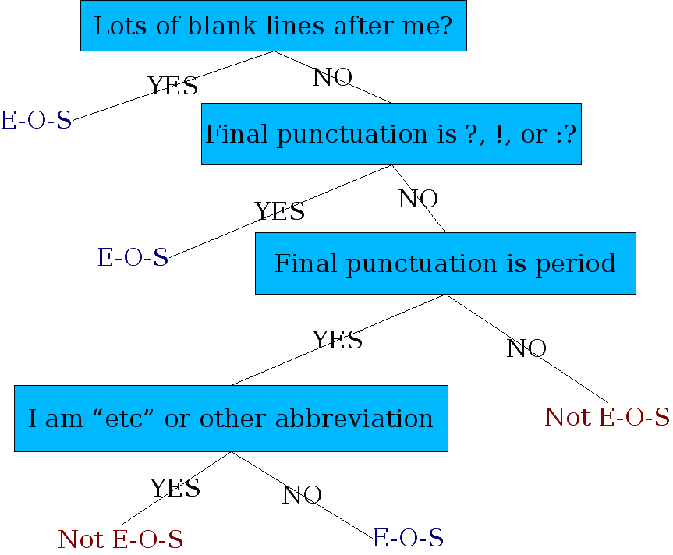
Determining if a word is end-of-sentence: a Decision Tree

Slide 65
Minimum Edit Distance
Definition of Minimum Edit Distance

Slide 66
How similar are two strings?
Spell correction
The user typed “graffe”
Which is closest?
graf
graft
grail
giraffe
Computational Biology
Align two sequences of nucleotides
Resulting alignment:
AGGCTATCACCTGACCTCCAGGCCGATGCCC
TAGCTATCACGACCGCGGTCGATTTGCCCGAC
-AGGCTATCACCTGACCTCCAGGCCGA--TGCCC---
TAG-CTATCAC--GACCGC--GGTCGATTTGCCCGAC
Also for Machine Translation, Information Extraction, Speech Recognition

Slide 67
Edit Distance
The minimum edit distance between two strings
Is the minimum number of editing operations
Insertion (I)
Deletion (D)
Substitution (S)
Needed to transform one into the other

Slide 68

Minimum Edit Distance
Two strings and their alignment:

Slide 69
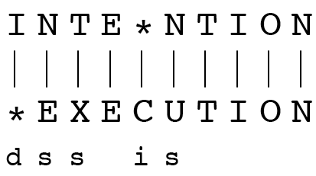
Minimum Edit Distance
If each operation has cost of 1
Distance between these is 5
If substitutions cost 2 (Levenshtein)
Distance between them is 8

Slide 70
Alignment in Computational Biology
Given a sequence of bases
An alignment:
Given two sequences, align each letter to a letter or gap
AGGCTATCACCTGACCTCCAGGCCGATGCCC
TAGCTATCACGACCGCGGTCGATTTGCCCGAC
-AGGCTATCACCTGACCTCCAGGCCGA--TGCCC---
TAG-CTATCAC--GACCGC--GGTCGATTTGCCCGAC

Slide 71
Weighted Edit Distance
Why would we add weights to the computation?
Spell Correction: some letters are more likely to be mistyped than others
Biology: certain kinds of deletions or insertions are more likely than others

Slide 72
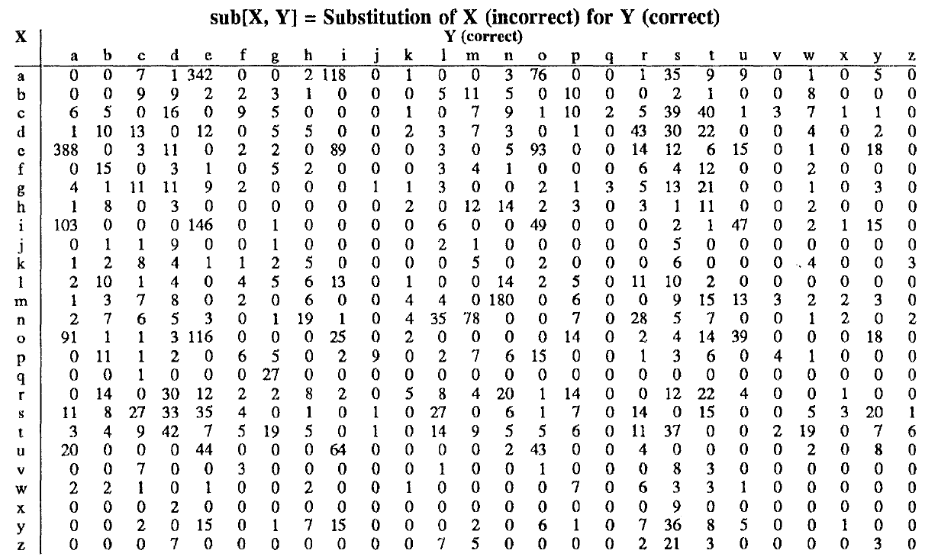
Confusion matrix for spelling errors

Slide 73
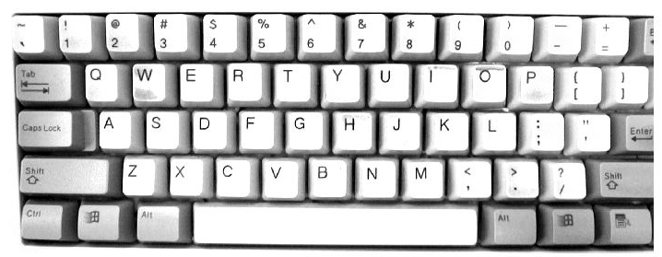

Slide 74
Book Reference
Jurafsky and Martin:
Speech and Language Processing
https://web.stanford.edu/~jurafsky/slp3/

Slide 75


Questions ☺
Thanks … Grazie … شكرا … Gracias … Merci … 谢谢 (Xièxiè)

